Slide 1
Transmission Control Protocol/Internet Protocol (TCP/IP)

Slide 2
TCP/IP Core Protocols (1 of 3)
TCP/IP is a suite of protocols including:
TCP, IP (IPv4 and IPv6), UDP, ARP, and many others
TCP/IP protocols add a header to data inherited from the layer above it
Layers 7, 6, and 5 - Data and instructions, known as payload, are generated by applications running on source host
Layer 4 – A Transport Layer protocol, usually TCP or UDP, adds a header to the payload
Includes a port number to identify the receiving app

Slide 3
TCP/IP Core Protocols (1 of 3)
Layer 3 - Network layer adds it own header and becomes a packet
Layer 2 - packet is passed to Data Link layer on NIC, which encapsulates data with its own header and trailer, creating a frame
Layer 1 - Physical layer on the NIC receives the frame and places the transmission on the network

Slide 4
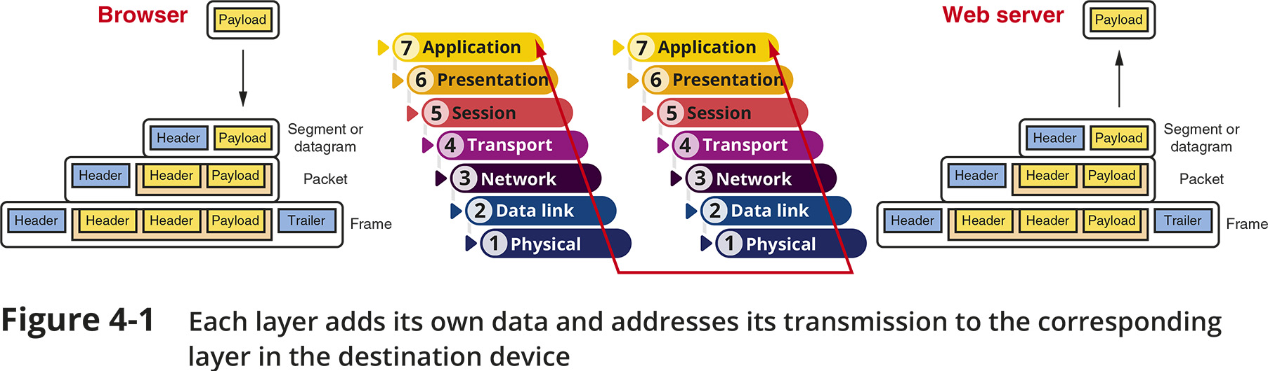
TCP/IP Core Protocols (2 of 3)

Slide 5
TCP/IP Core Protocols (3 of 3)
The receiving host decapsulates the message at each layer in reverse order and presents payload to the receiving applications
In transit, transmissions might pass through a number of connectivity devices
Connectivity devices are specialised devices that allow two or more networks or multiple parts of one network to connect and exchange data
Known by the highest OSI layer they read and process

Slide 6
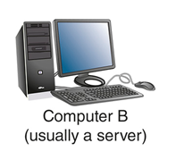
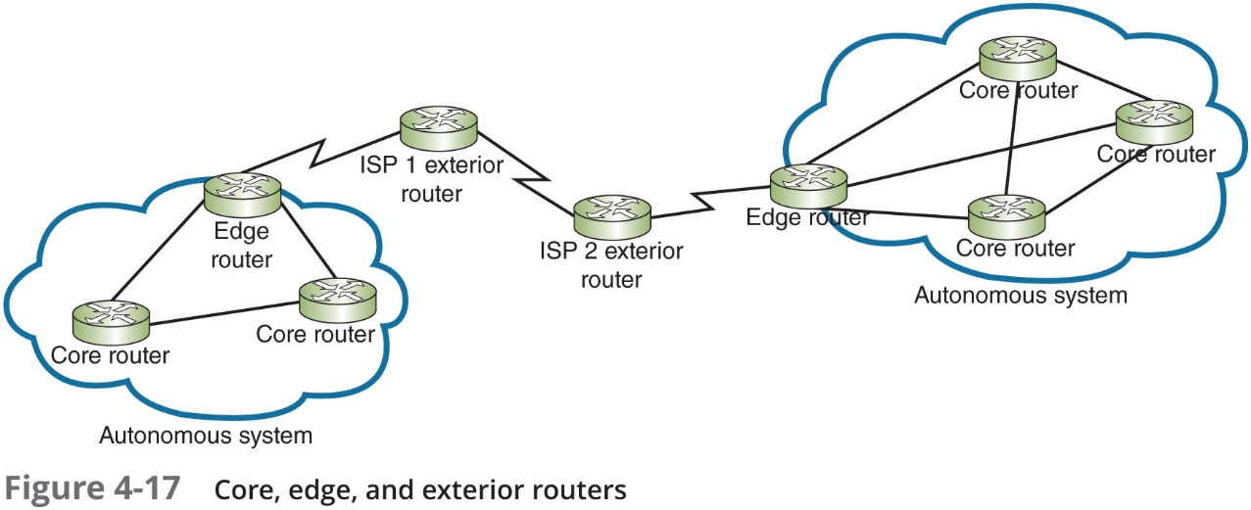
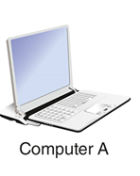
Transport Layer
End to end connection

Slide 7
TCP (Transmission Control Protocol) (1 of 4)
TCP operates in the transport layer of OSI model
Three characteristics of TCP:
Connection-oriented - TCP ensures that a connection or session is established by using a three-step process called a three-way handshake
Sequencing and checksums - TCP sends a character string called a checksum that is checked by the destination host along with a sequence number for each segment
Flow control - gauges rate of transmission based on how quickly recipient can accept data

Slide 8
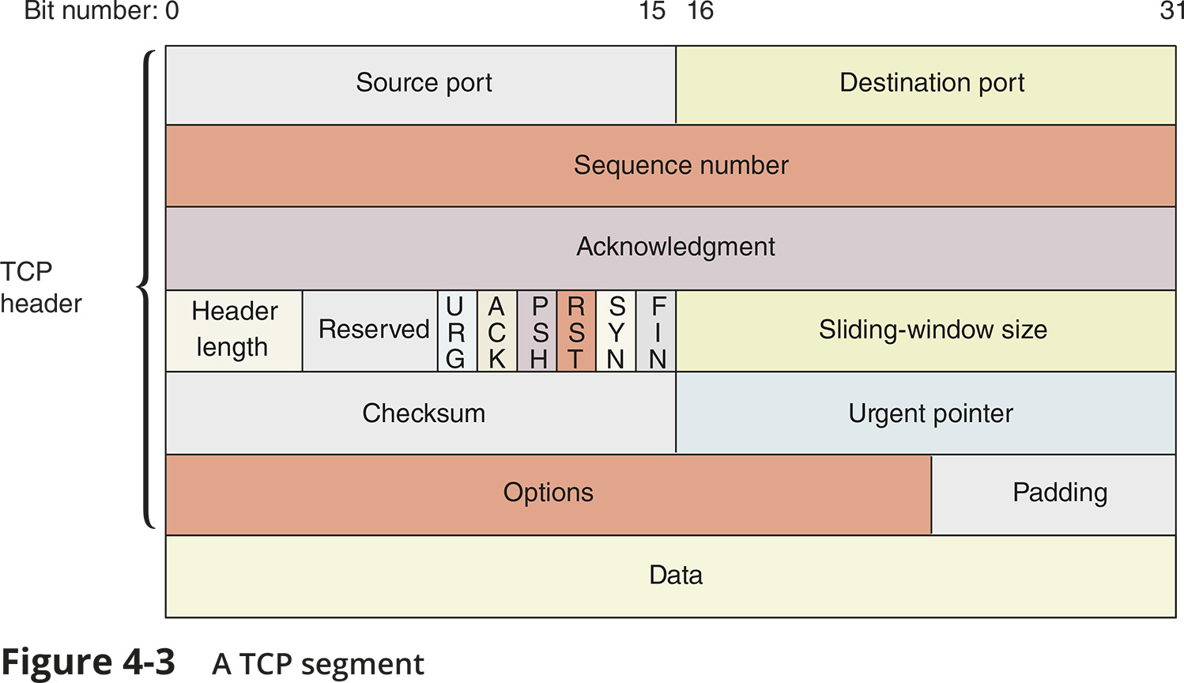
TCP (Transmission Control Protocol) (2 of 4)

Slide 9
TCP (Transmission Control Protocol) (3 of 4)
The TCP three-way handshake establishes a session before TCP transmits actual data
Three transmissions are sent before data transmission:
Step 1 – a request for a connection (SYN)
Step 2 – a response to the request (SYN/ACK)
Step 3 – a connection is established (ACK)
After the three initial messages, the payload or data is sent
Sequence numbers will be increased by the number of bits included in each received segment
Confirms the correct length of message was received

Slide 10
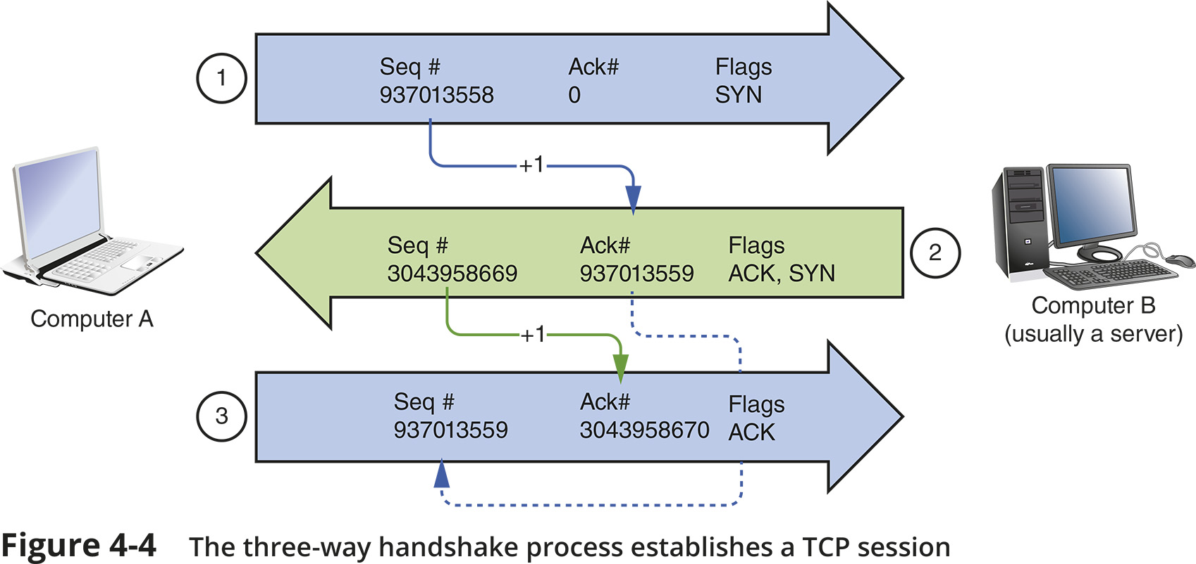
TCP (Transmission Control Protocol) (4 of 4)

Slide 11
UDP (User Datagram Protocol)
UDP is an unreliable, connectionless protocol
No three-way handshake is performed
UDP does not guarantee delivery of data
UDP provides no error checking, sequencing, or flow control
This makes UDP more efficient than TCP
Useful for live audio or video transmissions over the Internet
Also, more efficient for carrying messages that fit within one data packet
A UDP header contains only four fields: Source port, Destination port, Length, and Checksum
Use of Checksum field in UDP is optional in IPv4, but required in IPv6

Slide 12
IP (Internet Protocol) (1 of 3)
IP operates at the network layer of the OSI model
It specifies where data should be delivered
Identifies the data’s source and destination IP addresses
IP enables TCP/IP to internetwork
To traverse more than one LAN segment and more than one type of network through a router
IP is an unreliable, connectionless protocol
That means that IP does not guarantee delivery of data and no session is established before data is transmitted
IP depends on TCP to ensure messages are put back together in the right order and to ensure each message reaches the correct application on the receiving host

Slide 13
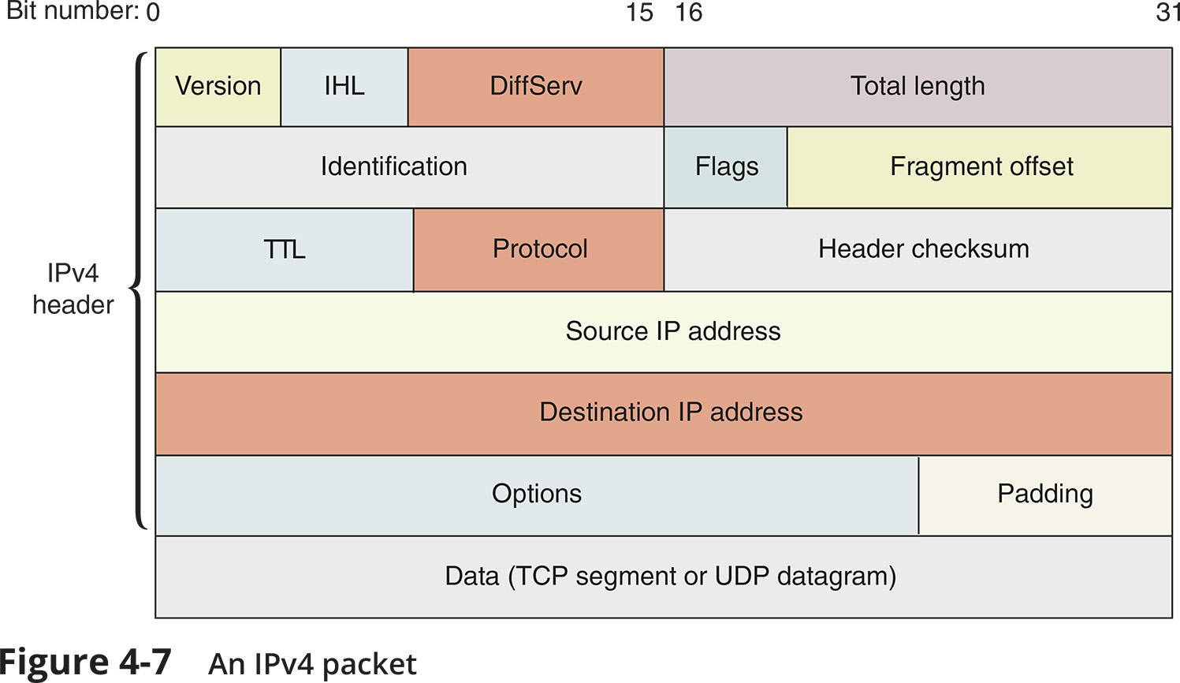
IP (Internet Protocol) (2 of 3)

Slide 14
IP (Internet Protocol) (3 of 3)
IPv6 Packets
IPv6 uses a different packet format than IPv4
IPv6 can accommodate the much longer IPv6 addresses
There is no Fragment offset field
IPv6 hosts adjust their packet sizes to fit the requirements of the network before sending IPv6 messages

Slide 15
ICMP (Internet Control Message Protocol)
ICMP is a core network layer protocol that reports on the success or failure of data delivery
ICMP can indicate the following:
When part of a network is congested
When data fails to reach its destination
When data has been discarded because the allotted TTL has expired
ICMP announces transmission failures to the sender but does not correct errors it detects
It provides critical information for troubleshooting network problems
ICMPv6 on IPv6 networks performs the functions of ICMP and ARP on IPv4 networks

Slide 16
ARP (Address Resolution Protocol) on IPv4 Networks (1 of 2)
ARP works in conjunction with IPv4 to discover the MAC address of a host or node on the local network
And to maintain a database that maps IP addresses to MAC addresses on the local network
ARP is a Layer 2 protocol that uses IP in Layer 3 and relies on broadcasting
Operates only within its local network

Slide 17
ARP (Address Resolution Protocol) on IPv4 Networks (1 of 2)
ARP table is the database of IP-to-MAC address mappings
An ARP table can contain two types of entries:
Dynamic - created when a client makes an ARP request that could not be satisfied by data already in the ARP table
Static - those someone entered manually using the ARP utility (arp command)
To view a Window’s workstation’s ARP table, enter the command:
arp -a

Slide 18
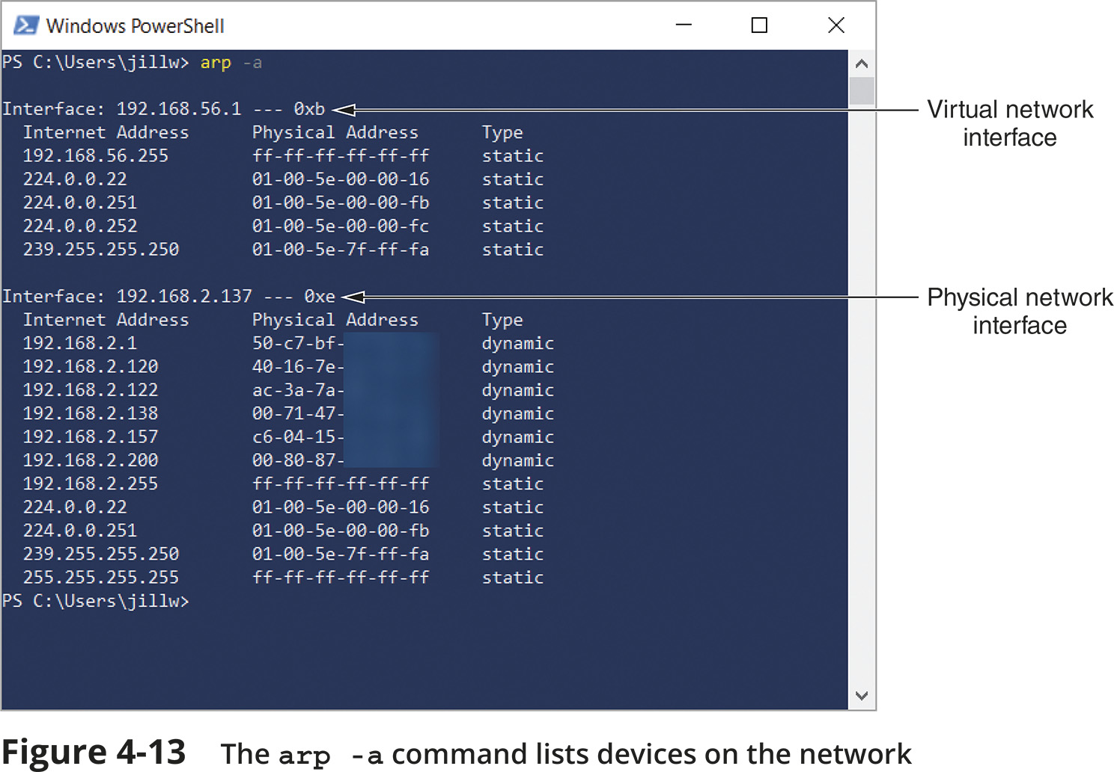
ARP (Address Resolution Protocol) on IPv4 Networks (2 of 2)

